Slide 1
Enhancement
07 August 2026

Slide 2
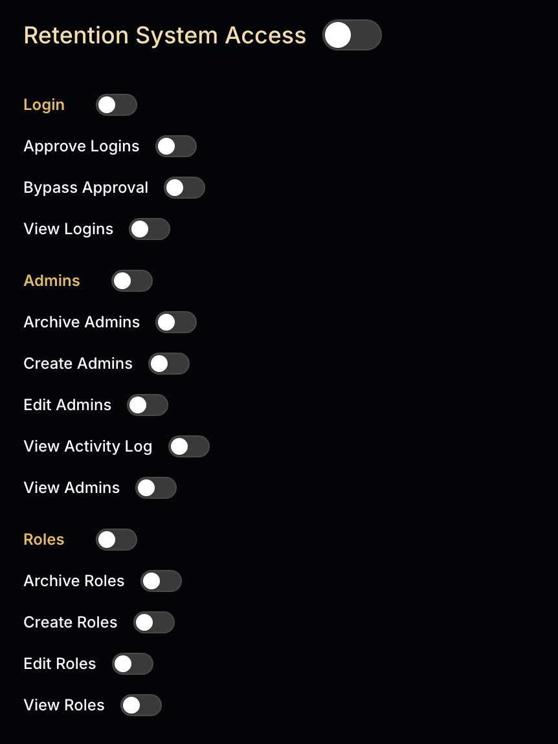
Retention System Access
Add "View Member Phone Number" permission.
If disabled, users cannot view phone numbers of members not assigned to them.
Users can only view phone numbers of their own assigned members.

Slide 3
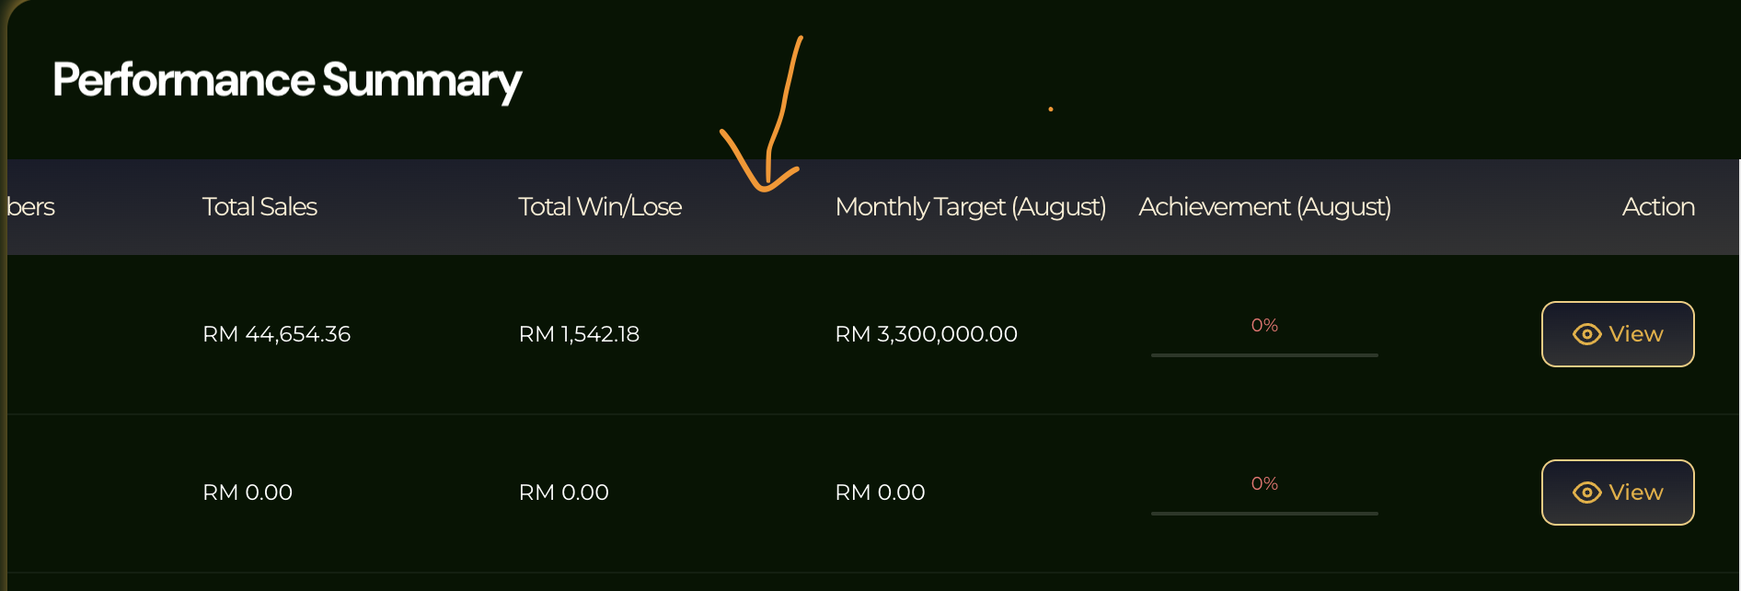
Add column repeat rate
Notes:
Question 1. Please let me know the Calculation - Repeat Rate = Members with 2+ successful deposits ÷ Total Assigned Members × 100%

Slide 4
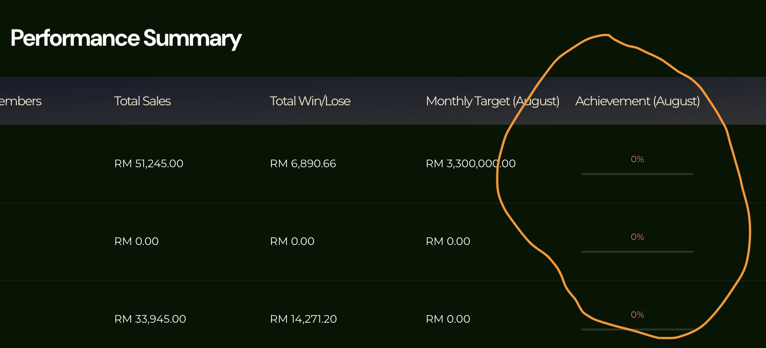
Achievement no function
Notes:
Question 1. Please let me know the Calculation
- Achievement % = Actual Result ÷ Target × 100%
# already discussed the calculation before. I added the target amount, but the Achievement % is still the same.

Slide 5
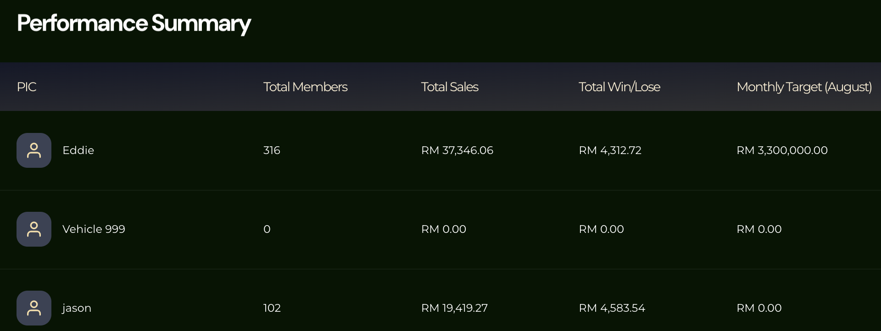
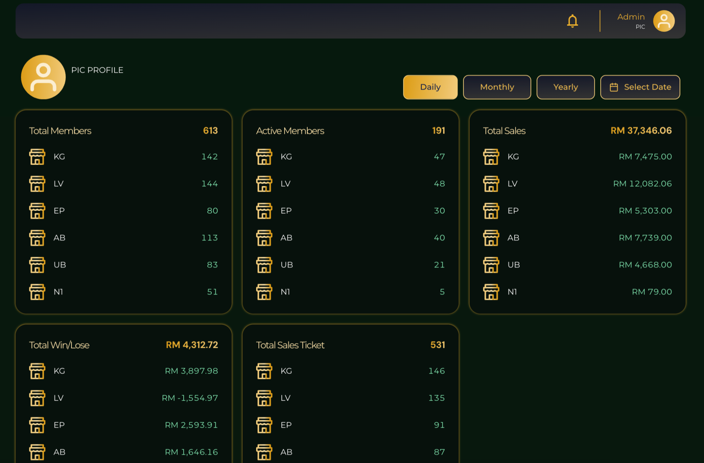
All data (Total Members, Total Sales, Total Win/Lose, Total Sales Ticket) should be calculated based on the assigned members only.
Issue 1: PIC Profile Name Display
When clicking PIC (Eddie / Jason) from Performance Summary, the PIC Profile page should display the selected PIC name.
Currently, the PIC name is not shown correctly.
Issue 2: PIC Profile Data Mismatch
The Total Members shown in PIC Profile does not match the actual assigned members.
Example:
Eddie assigned members: 310+ members
PIC Profile shows Total Members: 613
Notes:
Question 1. Did you need add on total sales ticket in this table? As i saw in system dont have this 2. Which mean for now the calculation is based on all ?
1. No need
2. The current calculation result is incorrect.
I’m not sure where the current data is pulling from, but the displayed data does not match the PIC’s assigned members.
The calculation should be based on each PIC’s assigned members only.
Example: If Jason has 100 assigned members, Jason’s Performance Summary should only calculate data from these 100 members.
Same for Eddie, the Performance Summary should only calculate based on Eddie’s assigned members.

Slide 6
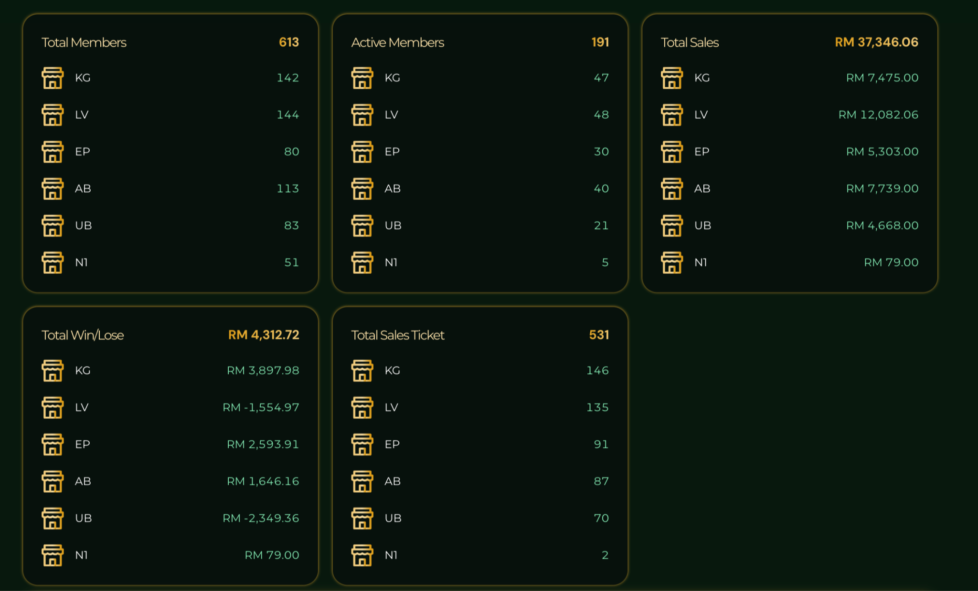
Add Repeat Rate
Add Total Repeat Rate
Add Brand Repeat Rate
KG
LV
EP
AB
UB
N1
Repeat Rate = Members with 2 or more successful deposits ÷ Total Active Members × 100%
Notes:
Question 1. Also calculate by assigned member?
1，yes ，correct

Slide 7
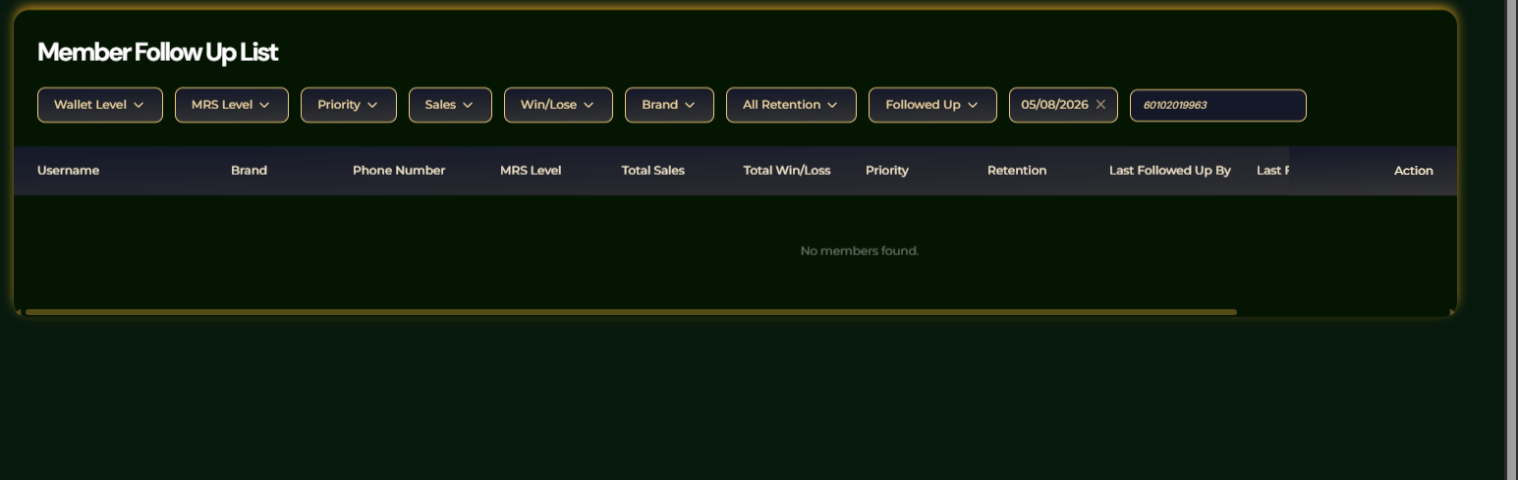
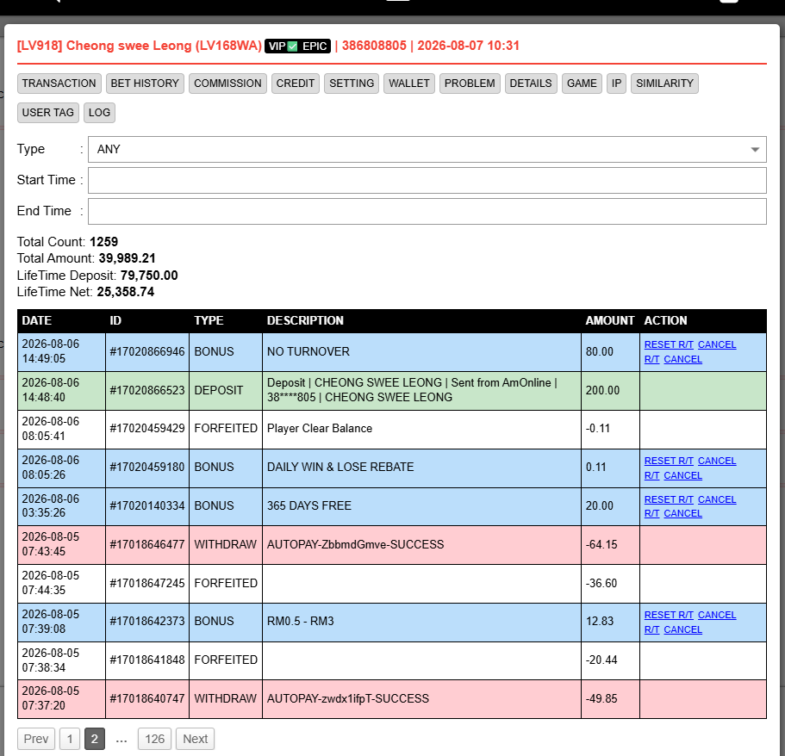
NS has the member transaction data, but Retention System cannot show the same data. Please help check the data sync.
Member Details: Name: Cheong Swee Leong Phone Number: 60102019963 Username: 386808805
Please ensure all customer data is synced correctly, so we can search and take the correct action when following up with customers.

Slide 8
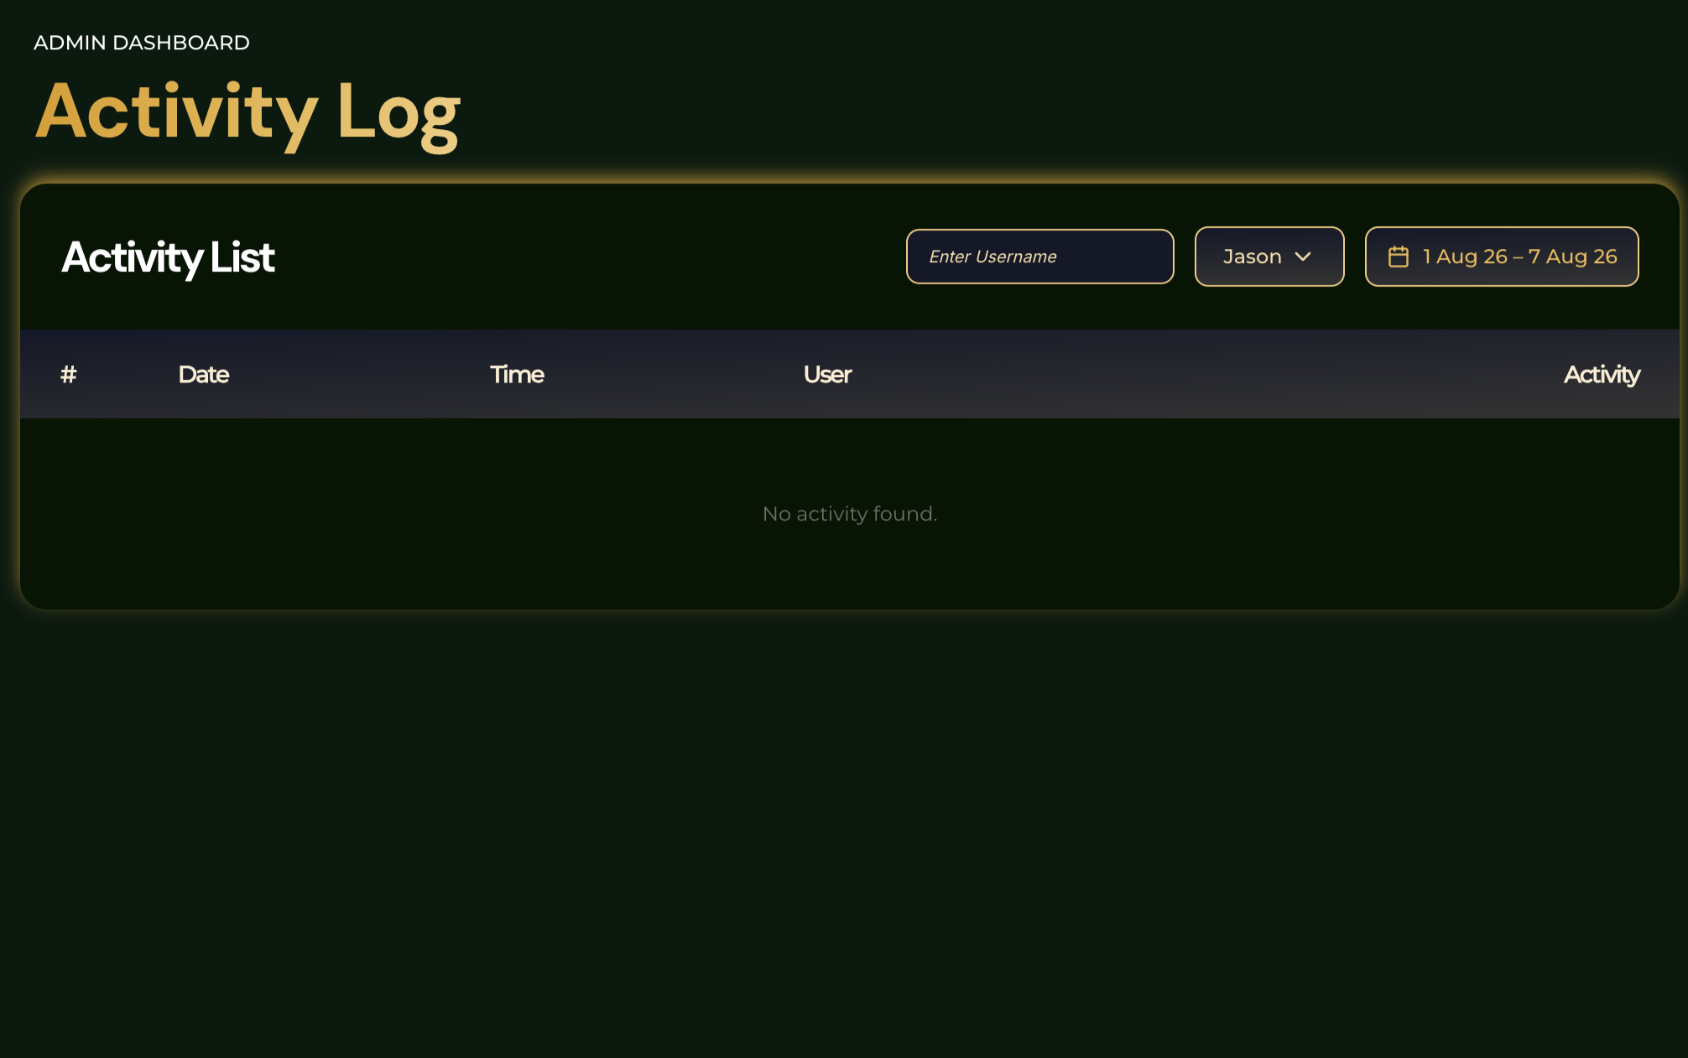
Activity log no function

Slide 9
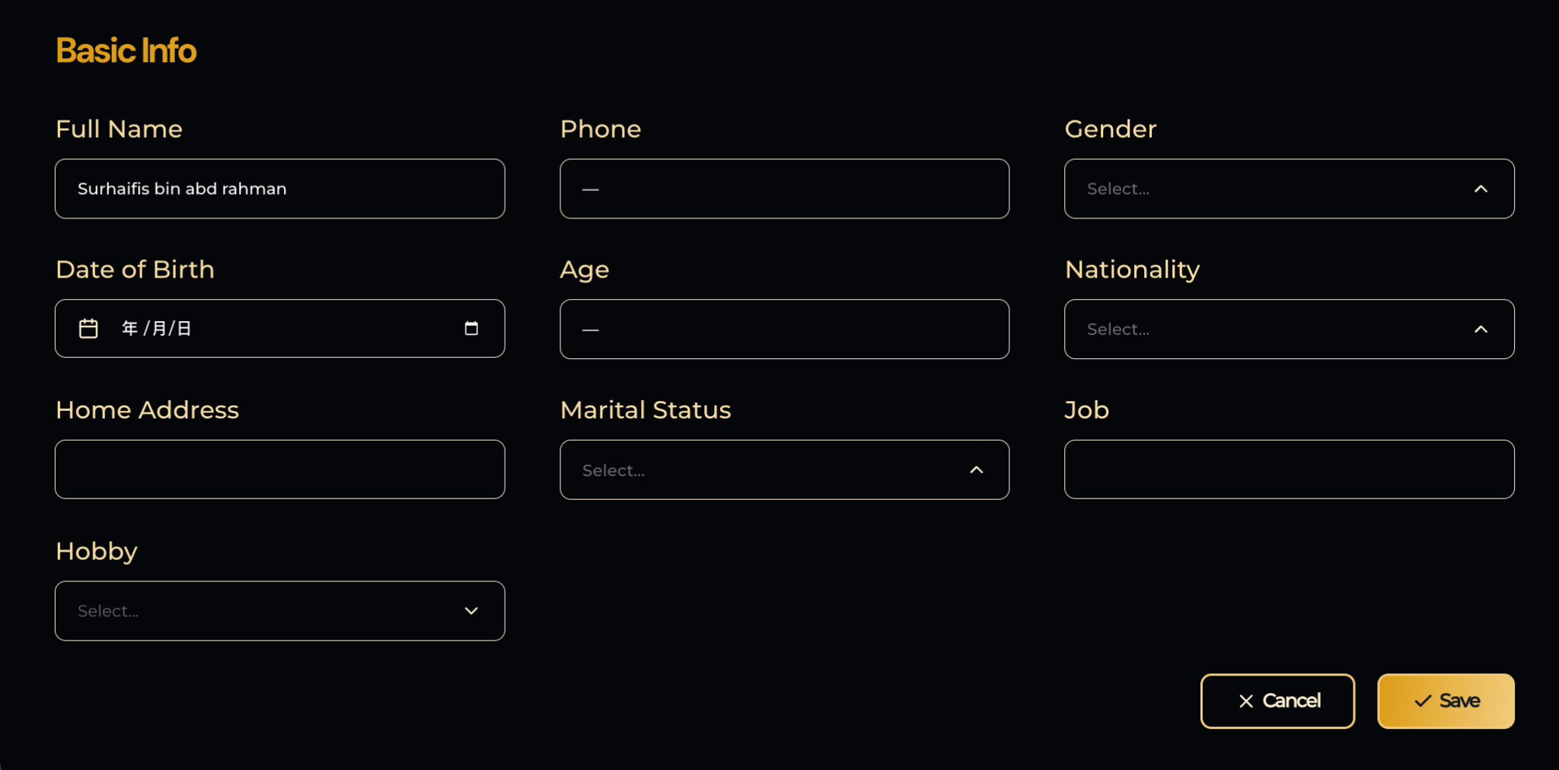
Save button has no function.
When clicking the Save button, there is no response and the data is not saved.

Slide 10
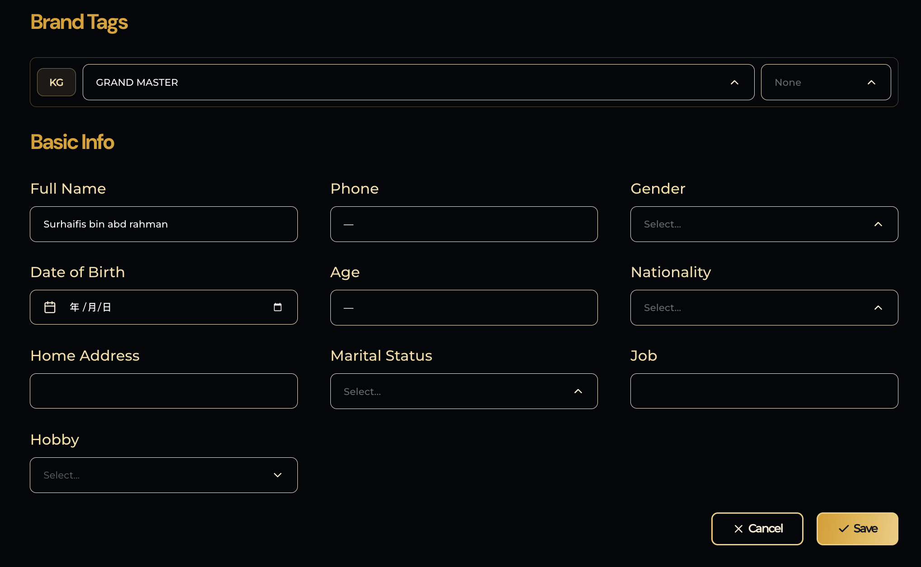
Change Hobby from dropdown to manual input.

Slide 11
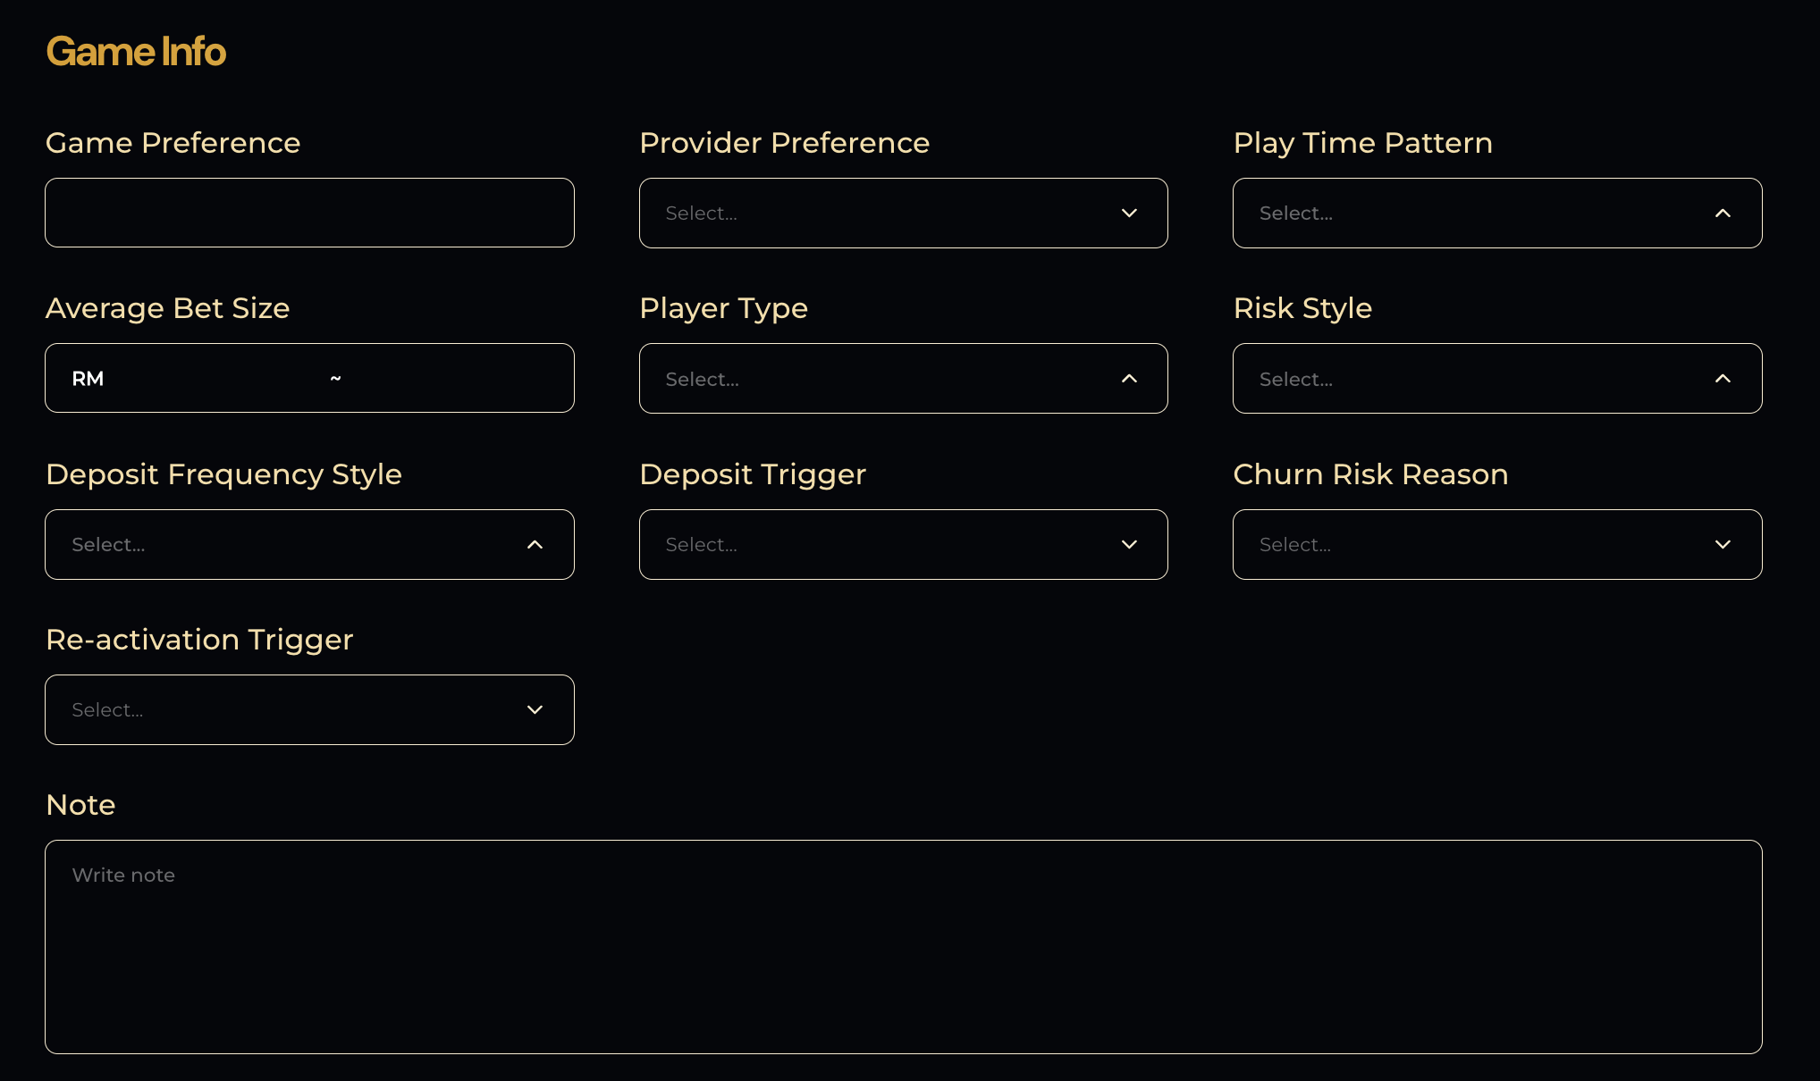
Change Provider Preference from dropdown to manual input.

Slide 12
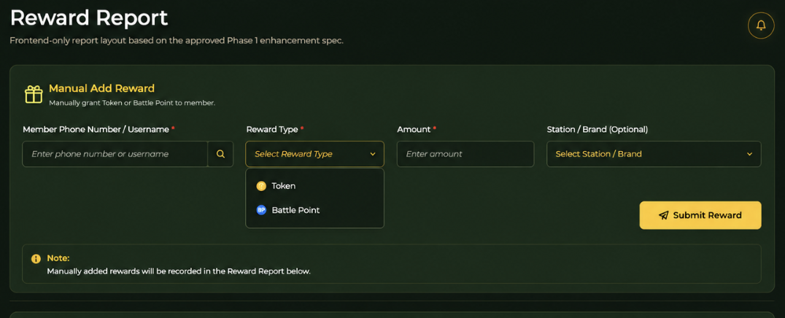
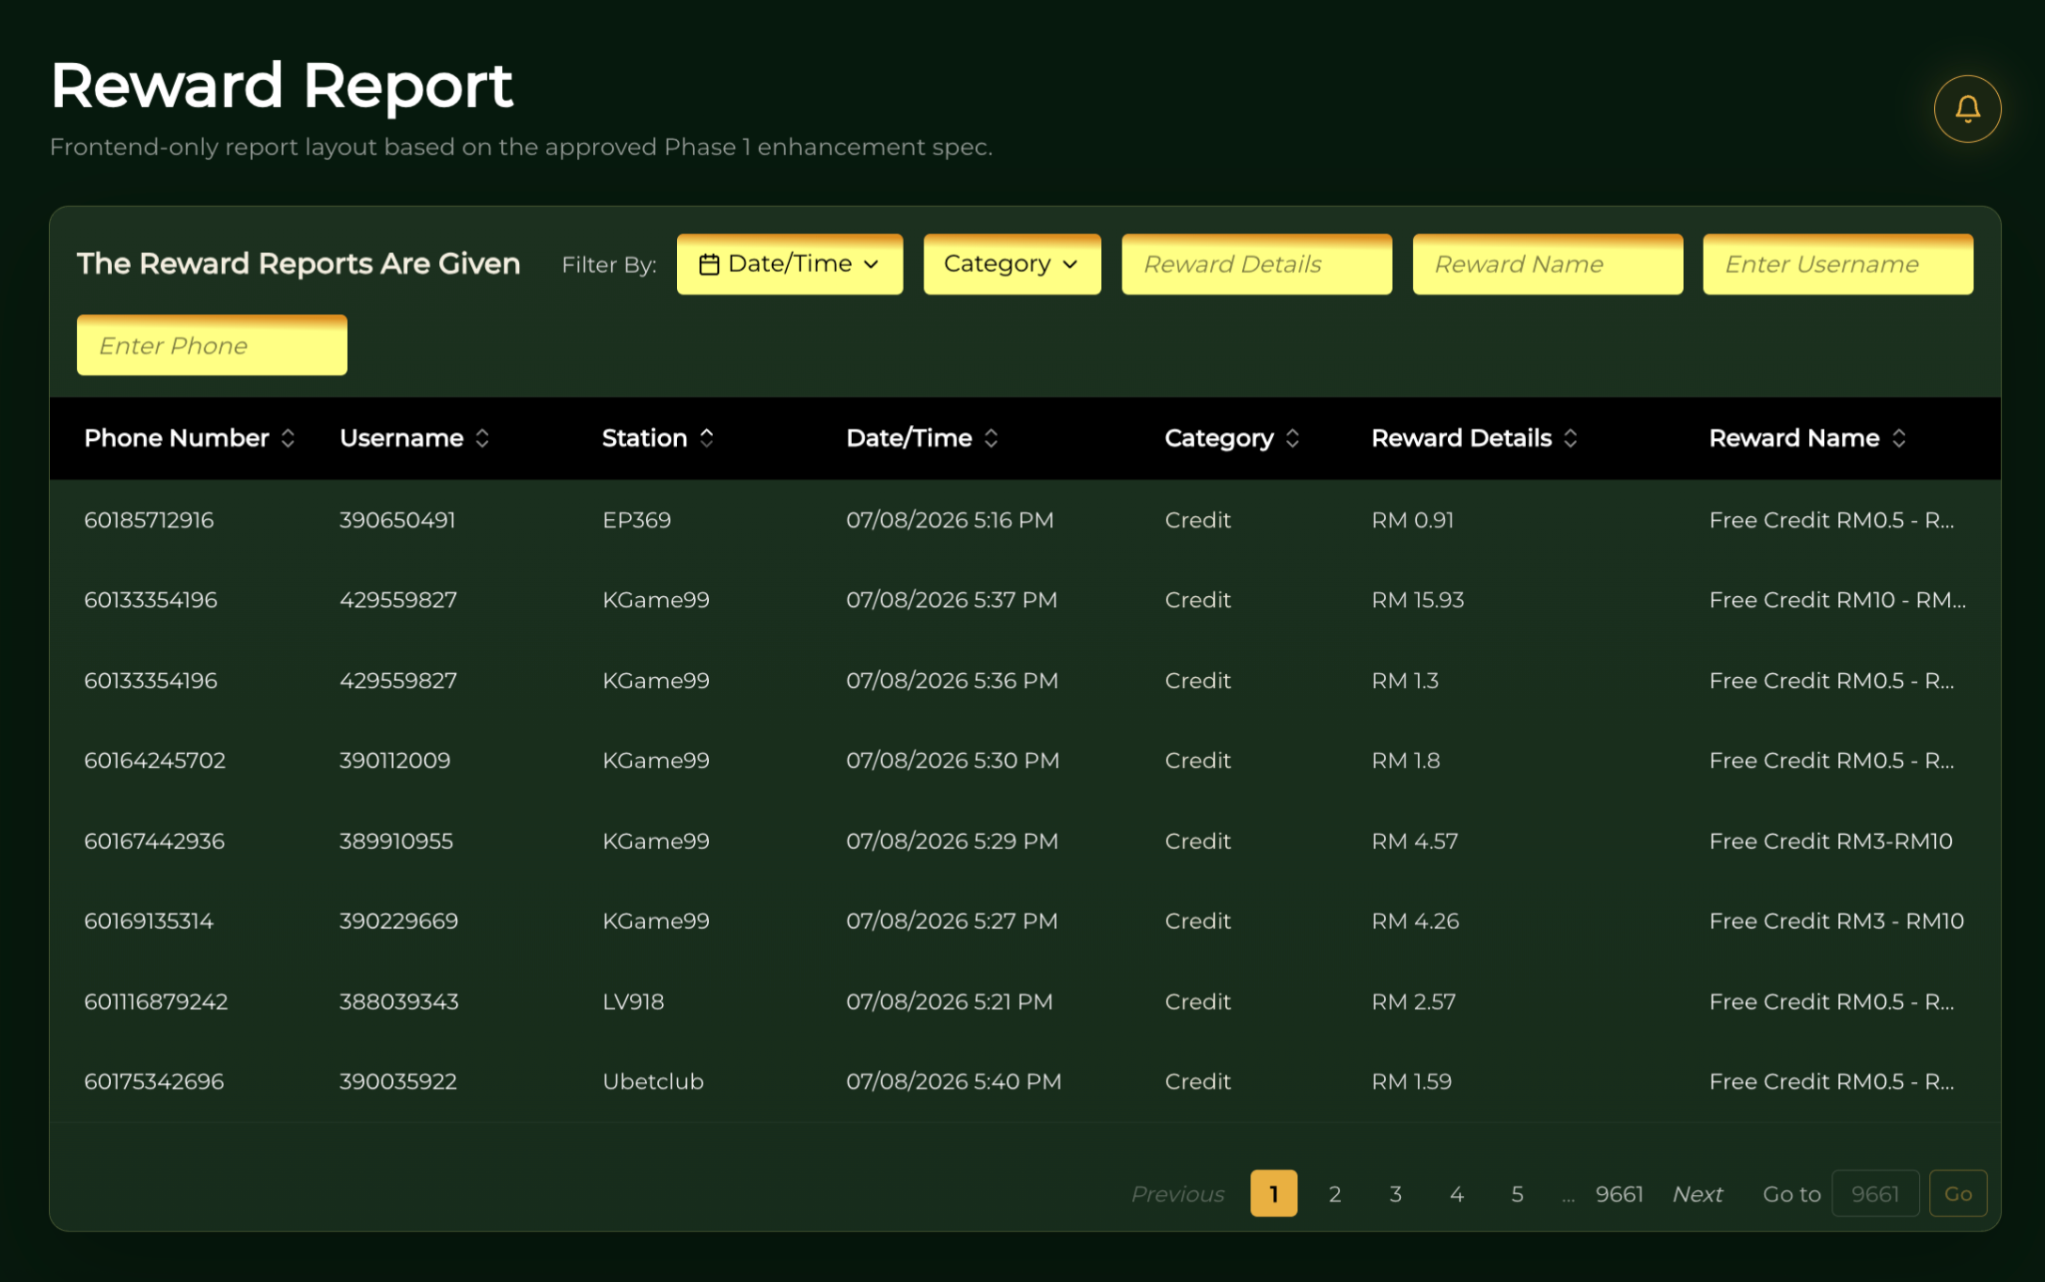
Sample
Reward Report – Add Manual Reward Function
Requirement: Add a manual reward function above the Reward Report table.
Admin can manually grant:
Token
Battle Point
Required fields:
Member Phone Number / Username
Reward Type (Token / Battle Point)
Amount

Slide 13
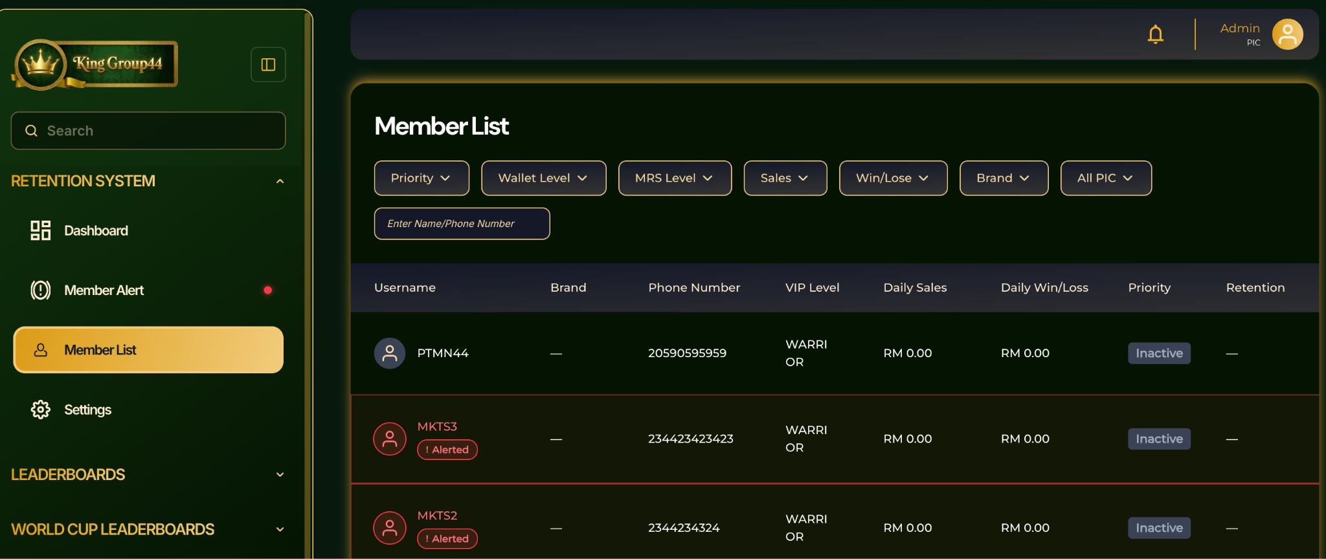
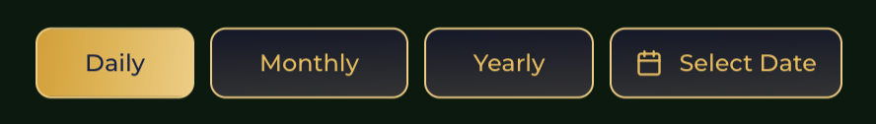
Member List – Add Date Filter
Please add the following filters to the Member List:
Daily / Monthly / Yearly / Select Date
Member List – Add Date Filter
Please add a Date Filter to the Member List.
If the Admin only selects the Date without selecting any other filter, the list will default to Daily Sales – Highest to Lowest.
If the Admin selects any other filter option, the results will follow the selected Date + selected filter option.

Slide 14
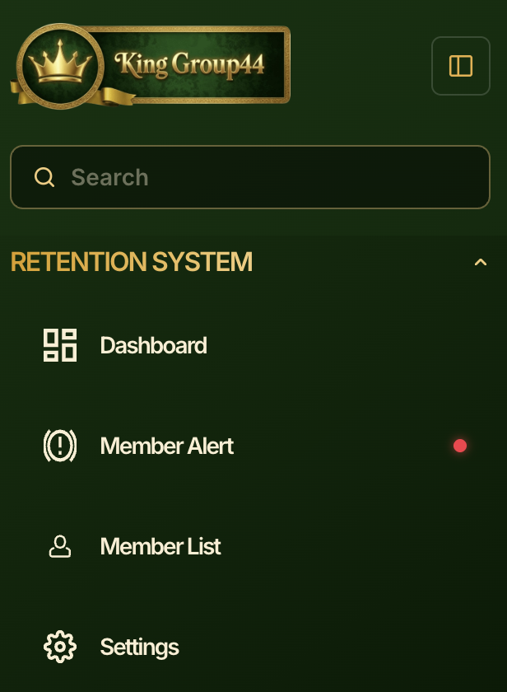
Add Error transaction here
API will catch error transaction and show up here
Admin need to check and delete the error transaction

